Slide 1
MoESD & BEC 7th Annual Excellence Awards Ceremony
8th July 2016

Slide 2
Why Excellence?
History of the awards
The need to recognise and propel citizens towards excellence
The danger of complacency and being content with mediocrity; not everybody can innovate or propel us forward in achievements
Notes:
The recent send-off of Botswana trained teachers to the Seychelles, which you Hon Minister ushered in, is no mean feat. We should aim to export intellect alongside our minerals and processed goods. And I say this in an unassuming nor presumptuous but utmost of modest manner.

Slide 3
A Note of Inspiration for Awardees, Learners, Teachers, Parents & the Curriculum
Renewable/Clean Energy
Harnessing solar energy -http://www.solarimpulse.com/
From here to F/town in an electric car? Google Elon Musk and the Tesla car
Unprecedented sources of electricity “pee!” http://www.bbc.co.uk/newsround/36197379
http://www.news.com.au/technology/environment/microsoft-founder-bill-gates-drinks- glass-of-water-that-was-raw-sewage-just-five-minutes-earlier/news- story/8c2b3db22385dbead6d338ad90ce6dc3
Computer Code/Programming; Why?
watch https://www.youtube.com/watch?v=Ok6LbV6bqaE
How code is written view three-level introduction at https://www.youtube.com/watch?v=THOEQ5soVpY
Recommend code writing using LEGO-style tools e.g. SCRATCH developed at MIT Laboratories https://www.youtube.com/watch?v=4y6J2jXjU34
Ultimately google You Tube for graduating to a programming language, simpler yet faster
than C++ like Python and then onto coding using DNA genetic structure (google George Church of Harvard Medical School)
A free world-class educational resource for anybody, anywhere - https://www.youtube.com/user/khanacademy
Notes:
Your Excellency, Botswana ought to be at the leading edge of solar energy exploration
Flying around the world in a solar-powered plane to promote clean energy
Now a company in America has produced a machine, called an Omniprocessor, that not only safely gets rid of poo but converts it into water that's safe to drink, and produces electricity to spare.

Slide 4
Tapping into our Knowledge Systems
Need to interrogate what we already have that provides potential to draw on the virtues of our culture, create and innovate
-the advent of thobega predating modern telemedicine, Mosêlêsêlê sickle bush, Motlopi shephered tree, Letlhajwa toothbrush bush, Mogônônô silver cluster; minerals -letsoku, dolomite, sand stone and other minerals which adorn this country.
The mathematics of DITAOLA, divining bones; which have patterns like the double helix DNA model, and represents a very complex counting system -from a binary to part quarternary mathematical system
http://nasgem.rpi.edu
Notes:
Mosêlêsêlê sickle bush treats snake bite by application of the chewed leaf to the lesion;
Motlopi shepered tree treats inflamed eyes in cattle, haemorrhoids (piles), epilepsy;
Letlhajwa toothbrush bush treats body pains, eye trouble;
Mogônônô silver cluster leaf anti-purgatory and remedy for dysentery and other stomach problems
the code is very special because it is an amazing chimera of a binary code and a quartenary code making it technically quinary.It looks like a four bit binary code where someone used four different versions of 1 instead of just one type of 1 or decoration.

Slide 5
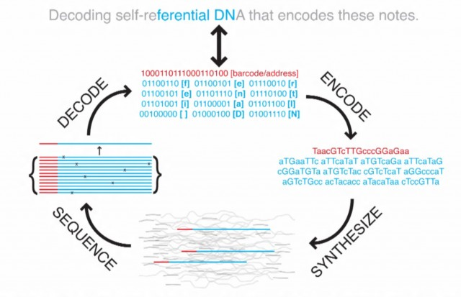
Notes:
George Church of Harvard Medical School and colleagues report that they have written an entire book in DNA, a feat that highlights the recent advances in DNA synthesis and sequencing. To do this, the authors converted the computational language of 0’s and 1’s into the language of DNA–the nucleotides typically represented by A’s, T’s G’s and C’s; the A’s and C’s took the place of 0’s and T’s and G’s of 1’s. They then used off-the-shelf DNA synthesizers to make 54,898 pieces of DNA, each 159 nucleotides long, to encode the book, which could then be decoded with DNA sequencing.

Slide 6
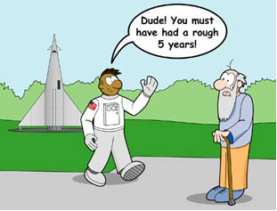
A Challenge to 2016 Awardees
http://spaceplace.nasa.gov/review/dr-marc-space/time-travel.html
https://www.youtube.com/watch?v=BnmrFrUkBv0
Notes:
Albert Einstein’s Special Relativity says that a surprising thing happens when you move through space-time, especially when your speed relative to other objects is close to the speed of light. Time goes slower for you than for the people you left behind. You won't notice this effect until you return to those stationary people.
Say you were 15 years old when you left Earth in a spacecraft traveling at about 99.5% of the speed of light (which is much faster than we can achieve now), and celebrated only five birthdays during your space voyage. When you get home at the age of 20, you would find that all your classmates were 65 years old, retired, and enjoying their grandchildren! Because time passed more slowly for you, you will have experienced only five years of life, while your classmates will have experienced a full 50 years. So, if your journey began in 2003, it would have taken you only 5 years to travel to the year 2053, whereas it would have taken all of your friends 50 years. In a sense, this means you have been time traveling. This is a way of going to the future at a rate faster than 1 hour per hour.
Time travel of a sort also occurs for objects in gravitational fields. Einstein had another remarkable theory called General Relativity, which predicts that time passes more slowly for objects in gravitational fields (like here on Earth) than for objects far from such fields. So there are all kinds of space and time distortions near black holes, where the gravity can be very intense.

Slide 7

Thank You for Your Attention

